Slide 1
Permutations
A permutation of a set S of objects is an ordered arrangement of the elements of S where each element appears only once:
e.g., 1 2 3, 2 1 3, 3 1 2
An ordered arrangement of r distinct elements of S is called an r-permutation.
The number of r-permutations of a set S with n=|S| elements is
P(n,r) = n(n−1)…(n−r+1) = n!/(n−r)!
Notes:
Discrete Mathematics and its Applications
(c)2001-2002, Michael P. Frank

Slide 2
Example
How many ways are there to select a third-prize winner from 100 different people who have entered a contest?
Notes:
Discrete Mathematics and its Applications
(c)2001-2002, Michael P. Frank

Slide 3
More Examples
A terrorist has planted an armed nuclear bomb in your city, and it is your job to disable it by cutting wires to the trigger device.
There are 10 wires to the device.
If you cut exactly the right three wires, in exactly the right order, you will disable the bomb, otherwise it will explode!
If the wires all look the same, what are your chances of survival?
P(10,3) = 10·9·8 = 720,
so there is a 1 in 720 chance that you’ll survive!
Notes:
Discrete Mathematics and its Applications
(c)2001-2002, Michael P. Frank

Slide 4
More Examples
How many permutations of the letters ABCDEFG contain the string ABC?
Notes:
Discrete Mathematics and its Applications
(c)2001-2002, Michael P. Frank

Slide 5
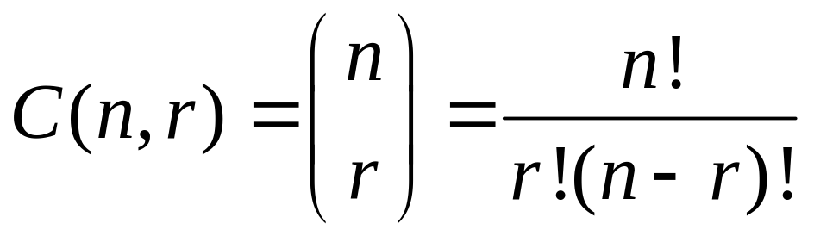
Combinations
The number of ways of choosing r elements from S (order does not matter).
S={1,2,3}
e.g., 1 2 , 1 3, 2 3
The number of r-combinations C(n,r) of a set with n=|S| elements is
Notes:
Discrete Mathematics and its Applications
(c)2001-2002, Michael P. Frank

Slide 6
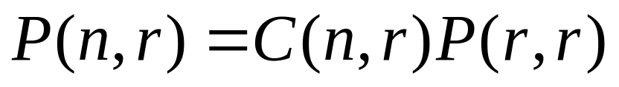
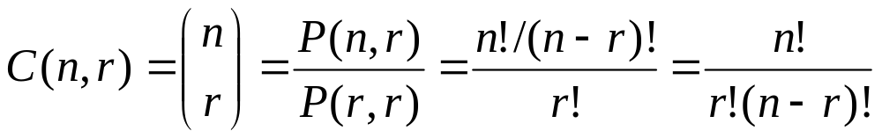
Combinations vs Permutations
Essentially unordered permutations …
Note that C(n,r) = C(n, n−r)
Notes:
Discrete Mathematics and its Applications
(c)2001-2002, Michael P. Frank

Slide 7
Combination Example
How many distinct 7-card hands can be drawn from a standard 52-card deck?
  The order of cards in a hand doesn’t matter.
Answer C(52,7) = P(52,7)/P(7,7)
= 52·51·50·49·48·47·46 / 7·6·5·4·3·2·1
17
10
7
8
2
52·17·10·7·47·46 = 133,784,560
Notes:
Discrete Mathematics and its Applications
(c)2001-2002, Michael P. Frank

Slide 8
More Examples
How many ways are there to select a committee to develop a discrete mathematics course if the committee is to consist of 3 faculty members from the Math department and 4 from the CS department, if there are 9 faculty members from Math and 11 from CS?
Notes:
Discrete Mathematics and its Applications
(c)2001-2002, Michael P. Frank

Slide 9
Generalized
Permutations and Combinations
How to solve counting problems where elements may be used more than once?
How to solve counting problems in which some elements are not distinguishable?
How to solve problems involving counting the ways we to place distinguishable elements in distinguishable boxes?
Notes:
Discrete Mathematics and its Applications
(c)2001-2002, Michael P. Frank

Slide 10

Permutations with Repetition
The number of r-permutations of a set of n objects with repetition allowed is
Example: How many strings of length n can be formed from the English alphabet?
Notes:
Discrete Mathematics and its Applications
(c)2001-2002, Michael P. Frank

Slide 11
Combinations with Repetition
The number of r-combinations from a set with n elements when repetition of elements is allowed are C(n+r-1,r)
Notes:
Discrete Mathematics and its Applications
(c)2001-2002, Michael P. Frank

Slide 12
Combinations with Repetition
Example: How many ways are there to select 5 bills from a cash box containing $1 bills, $2 bills, $5 bills, $10 bills, $20 bills, $50 bills, and $100 bills? Assume that the order in which bills are chosen does not matter and there are at least 5 bills of each type.
Notes:
Discrete Mathematics and its Applications
(c)2001-2002, Michael P. Frank

Slide 13
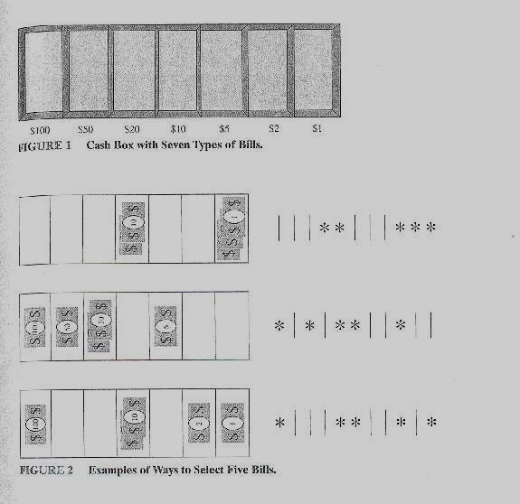
Combinations with Repetition
Approach: Place five markers in the compartments
i.e., # ways to arrange five stars and six bars ...
Solution: Select the positions of the 5 stars from 11 possible positions !
C(n+r-1,5)= C(7+5-1,5)=C(11,5)
n=7
r=5
compartments
and
dividers
markers
Notes:
Discrete Mathematics and its Applications
(c)2001-2002, Michael P. Frank

Slide 14
Combinations with Repetition
Example: How many ways are there to place 10 non-distinguishable balls into 8 distinguishable bins?
Notes:
Discrete Mathematics and its Applications
(c)2001-2002, Michael P. Frank

Slide 15
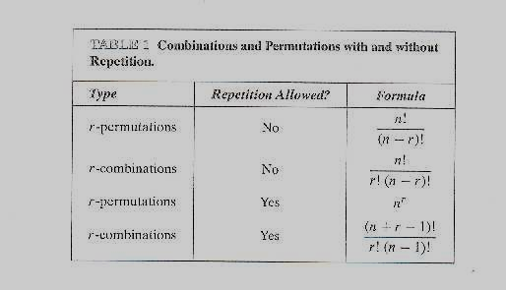
Permutations and Combinations with and without Repetition
Notes:
Discrete Mathematics and its Applications
(c)2001-2002, Michael P. Frank

Slide 16



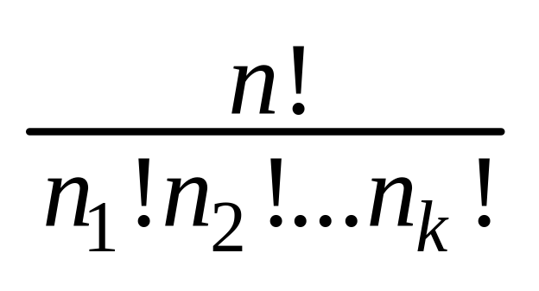



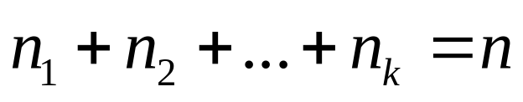
Permutations with non-distinguishable objects
The number of different permutations of n objects, where there are non-distinguishable objects of type 1, non-distinguishable objects of type 2, …, and non-distinguishable objects of type k, is
i.e., C(n, )C(n- , )…C(n- - -…- , )
Notes:
Discrete Mathematics and its Applications
(c)2001-2002, Michael P. Frank

Slide 17
Permutations with non-distinguishable objects
Example: How many different strings can be made by reordering the letters of the word
SUCCESS
Notes:
Discrete Mathematics and its Applications
(c)2001-2002, Michael P. Frank

Slide 18

Distributing Distinguishable
Objects into Distinguishable Boxes
The number of ways to distribute n distinguishable objects into k distinguishable boxes so that objects are placed into box i, i=1,2,…,k, equals
Notes:
Discrete Mathematics and its Applications
(c)2001-2002, Michael P. Frank

Slide 19
Distributing Distinguishable
Objects into Distinguishable Boxes
Example: How many ways are there to distribute hands of 5 cards to each of 4 players from the standard deck of 52 cards?
Notes:
Discrete Mathematics and its Applications
(c)2001-2002, Michael P. Frank

